Slide 1
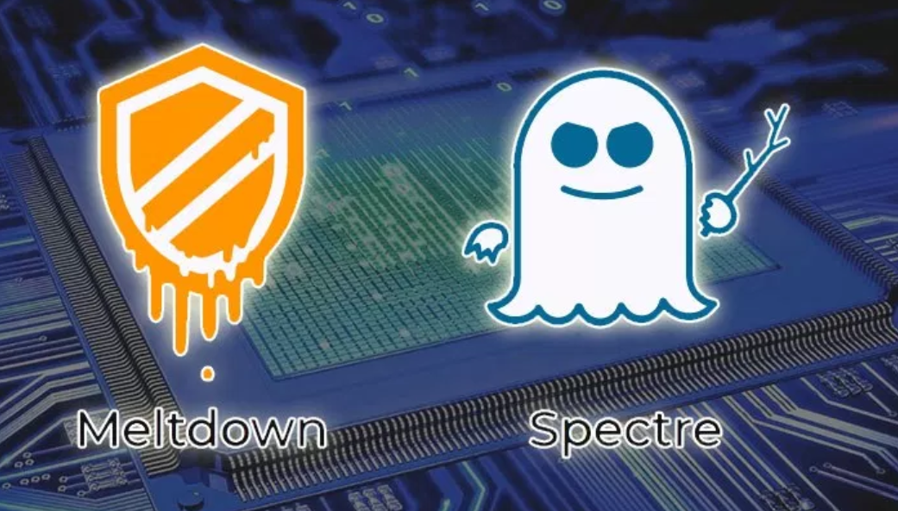
By free knowledge mission

Slide 2
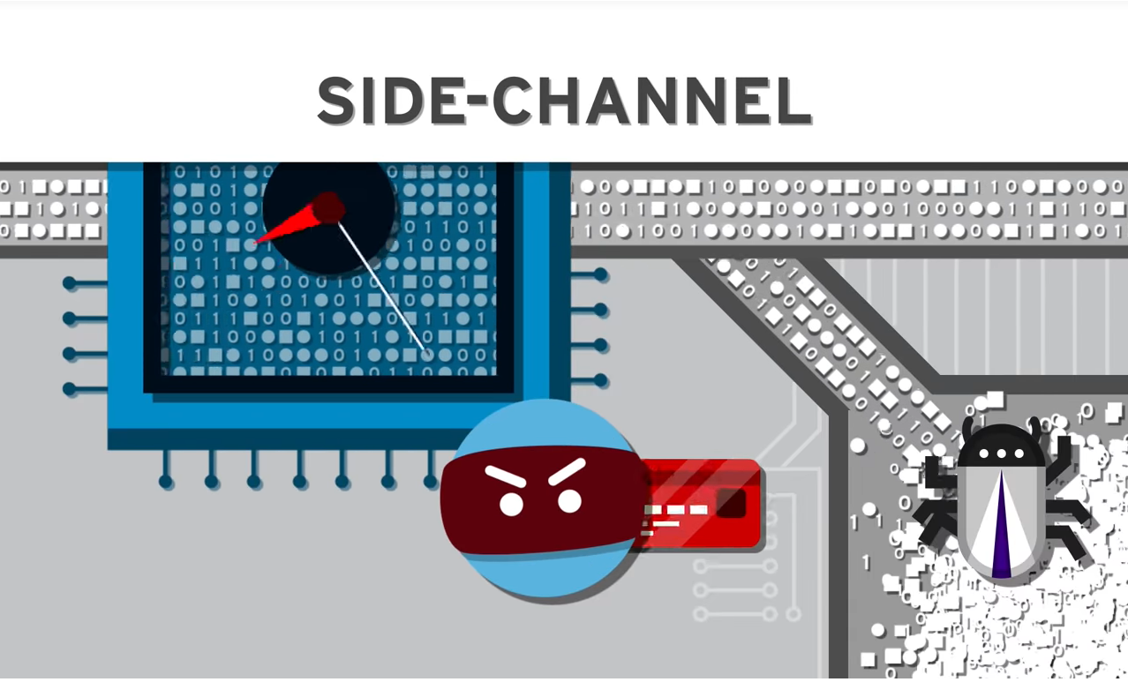
What is meltdown & Spectre?
Analogy
Let’s say your friend typically order coffee in the morning
You buy your friend coffee
If friend does want coffee, you’ve saved time
You friend is sick and wants juice instead
The coffee is not used

Slide 3
Specifics
CPU Design Architecture for speculative execution or branch execution
Designed when computers were centralized
Discovered last summer but kept secure to build fixes – Some fixes released early
No known security breaches
CPU Prediction speeds up processing nearly 30% for repetitive tasks
Bad predictions are not used but left in shared memory and left unsecure

Slide 4
Security design
Intended Security Design – Program predicts the next CPU tasks such as video decoding but cannot access secure information such as passwords
With reverse engineering, hackers have coded ways around it read secure information in the thrown away memory

Slide 5
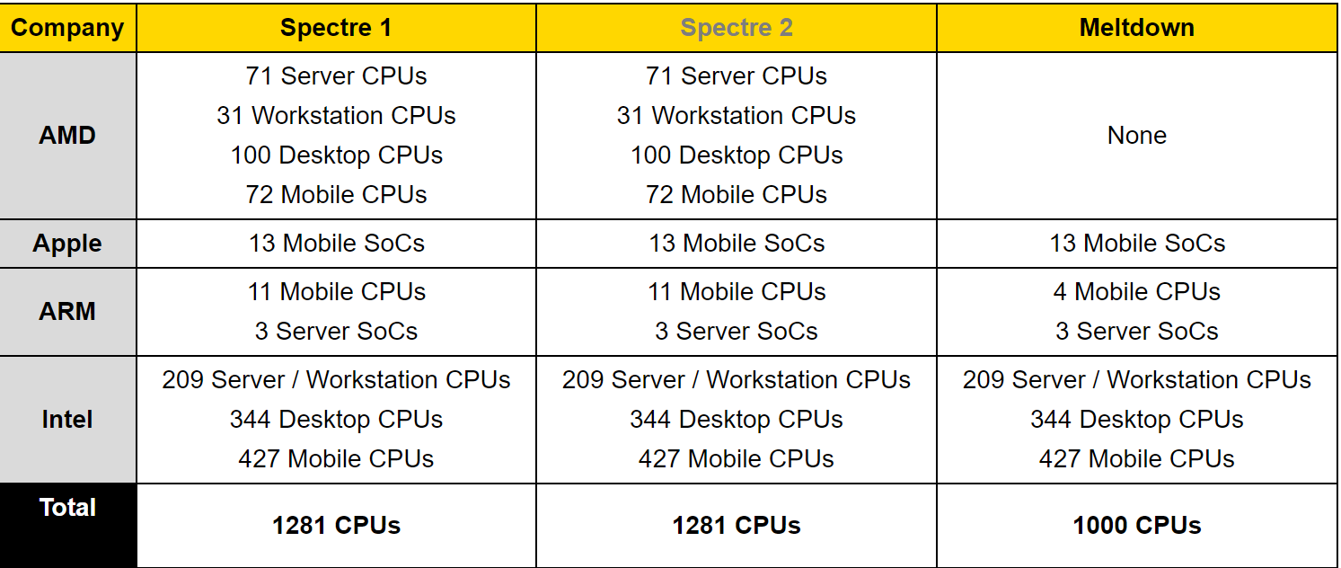
Who is effected?
Nearly all CPUs including Intel, Qualcomm, ARM, Intel
All operating system including Window, Mac, Linux
Nearly all Tablets, Smartphones, Desktops, & Servers
Summary of major CPUs effected

Slide 6
What’s the distinction?
Meltdown
Operating system – Individual programs effected
Single program accessing more memory than allowed causing meltdown
Can be patched with operating system software – limit memory sharing
Spectre
Named after speculative execution
Can get access to other programs memory
Requires hardware fixes – Intel releasing firmware update – It will most likely require new hardware redesign.

Slide 7
Resources
Find patches for your OS, Browser, and Antivirus
CPU’s effected

